Slide 1
Social Networking
Chekwoti Aramadhan
Islamic University in Uganda

Slide 2
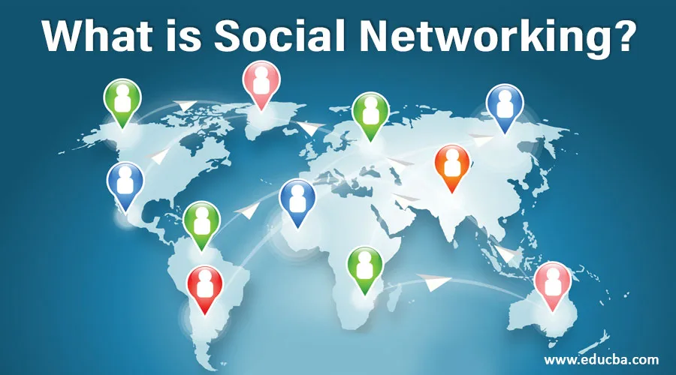
…

Slide 3
Introduction
The Internet has rapidly evolved from being merely an information sharing platform to being a social networking platform used by individuals to share content, opinions, and information.
Social networking is a global phenomenon that has revolutionized how people interact with each other.
They have become a central part of our daily lives as people spend more time socializing on the Internet.
It affects nearly every aspect of our life: education, communication, employment, politics, healthcare, social relationships, and personal productivity.

Slide 4
Concept of Social Networking
Social networking refers to the use of internet-based platforms to connect individuals, share information, and form relationships.
According to Ellison and Boyd (2013), social networking sites (SNS) allow users to create identifiable profiles that consist of user-supplied content and connect with others through shared interests or experiences.
The primary purpose of social networking is to foster communication and collaboration among users, enabling them to exchange ideas, resources, and support.

Slide 5

…

Slide 6
Types of social networks
Social networks can be categorized into several types based on their primary functions:
Social Connections Networks:
These platforms focus on connecting friends and family members. Examples include Facebook and Instagram, where users can share personal updates, photos, and videos.
Professional Networks:
Geared towards career development and professional relationships, these networks allow users to connect with colleagues and industry professionals. LinkedIn is a prime example.

Slide 7
…
Content Sharing Networks:
These platforms enable users to share multimedia content such as videos and images. YouTube and Flickr are notable examples where users can upload and share their creative works.
Informational Networks:
These networks focus on sharing news, tutorials, or how-to content. Reddit and Stack Overflow are popular for fostering discussions around specific topics or problems.
Educational Networks:
Designed for academic collaboration, these platforms allow students and educators to connect for learning purposes. Examples include Google Classroom and ResearchGate.

Slide 8
…
Dating Networks:
These platforms help individuals find romantic partners based on shared interests or preferences. Tinder and Bumble are well-known dating apps.

Slide 9
POPULAR SOCIAL WEBSITES
Facebook- 3.05 billion monthly active users (MAUs), 200 million businesses (mostly small businesses), more than 7 million active advertisers
WhatsApp- 2.78 billion MAUs, WhatsApp Business reported having over 200 million monthly active users
YouTube- 2.49 billion MAUs. Besides being the second largest social media app, YouTube is often called the second largest search engine after Google, its parent company.
Instagram- 2.04 billion MAUs

Slide 10
…
WeChat – 1.32 billion MAUs
TikTok- 1.22 billion MAUs
Telegram- 800 million MAUs
X (Twitter)- 335.7 million MAUs
LinkedIn- 224 million MAUs

Slide 11
How do social networks work
https://www.youtube.com/watch?v=6a_KF7TYKVc

Slide 12
Applications of social networking
Social networks have numerous applications across various domains:
Social Interaction:
Social networking sites facilitate computer-mediated social interaction and make it possible to connect people who share interests and activities across political, economic, and geographic borders
Education:
Social networks are impacting the way students and educators engage in learning.
They are now used for learning, educator professional development, and content sharing.
Scientific communities use social media to exchange knowledge.
Researchers and librarians use social networks frequently to maintain professional relationships and share ideas.

Slide 13
…
Healthcare:
Social media enables different types of social connectivity among different stakeholders such as doctors, patients, and caregivers.
Social networking is an effective tool for teaching and learning for doctors and nurses as SNS is used to provide new information from research and assist in providing quality care to their patients
Politics:
Social networking seems to be impacting political life and political movements across the globe.
It has influenced voting and induced social changes, unrest, uprisings and revolutions all over the world.
Social networking will make government to be more accountable and enable citizens to exercise freedom of speech

Slide 14
..
Communication:
SNS facilitates real-time communication among users through messaging features, enabling personal interactions regardless of geographical barriers.
Marketing:
Businesses leverage social networks for marketing purposes by engaging customers through targeted advertisements and brand promotions. This has led to the rise of influencer marketing on platforms like Instagram.

Slide 15
…
Collaboration:
Researchers use academic social networks to share findings, collaborate on projects, and stay updated with peers in their field.
Personal branding
LinkedIn is a good platform for personal branding and business-to-business marketing
Social learning
Social network sites can be used as a social learning tool to reach a large population of internet users
Finding jobs

Slide 16
Social Media Campaigns
Social media campaigns are strategic efforts by organizations or individuals to promote a message or product through social networking platforms.
Effective campaigns typically involve:
Clear Objectives: Defining what the campaign aims to achieve (e.g., brand awareness, engagement).

Slide 17
..
Target Audience Identification: Understanding who the campaign is intended for helps tailor messaging appropriately.
Content Creation: Developing engaging content that resonates with the target audience is crucial for success.
Engagement Strategies: Encouraging user interaction through contests, polls, or direct calls-to-action can enhance participation.
Analytics and Feedback: Monitoring campaign performance through analytics tools allows for adjustments in real-time to improve outcomes.

Slide 18

examples

Slide 19

…

Slide 20
Impact of social networking on education
The integration of social networking into education offers numerous benefits:
Enhanced Learning Opportunities: Students can access diverse perspectives and resources from around the world through social media platforms.
Improved Collaboration: SNS fosters teamwork by allowing students to collaborate on projects regardless of geographical barriers. This collaborative environment encourages peer-to-peer learning.
Development of Digital Skills: Engaging with social media helps students develop essential digital literacy skills necessary for success in the modern workforce.
Creative Expression: Platforms like Instagram and TikTok provide opportunities for students to showcase their creativity through visual storytelling.

Slide 21
Negative impact
Distraction from Academic Tasks:
Cyberbullying and Online Harassment:
Information Overload:
Mental Health Concerns: Excessive

Slide 22
Benefits of Social Networks
Social networks offer numerous advantages:
Enhanced Communication: They facilitate instant communication across distances.
Access to Information: Users can quickly access diverse perspectives and resources.
Networking Opportunities: SNS provide avenues for professional networking that may lead to job opportunities or collaborations.
Community Building: Users can connect with like-minded individuals or groups based on shared interests.

Slide 23
Limitations of Social Networks
Despite their benefits, social networks also present several limitations:
Privacy Concerns: Users often face risks related to data privacy and security breaches.
Information Overload: The vast amount of information available can lead to difficulties in filtering relevant content.
Mental Health Issues: Excessive use of SNS has been linked to anxiety, depression, and other mental health concerns.
Misinformation Spread: Social networks can facilitate the rapid spread of misinformation or fake news.

Slide 24
summary
Social media: social Networking
https://www.youtube.com/watch?v=LVefs5M0YzA

Slide 25
Task/coursework
Group work:
Create a social media campaign of your choice for a new product or service.

